Slide 1

welcome

Slide 2
Mohammad Nazrul Islam
Lecturer
Nawab Habibullah Model School & College
Uttara Dhaka-1230

Slide 3

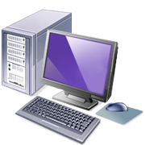

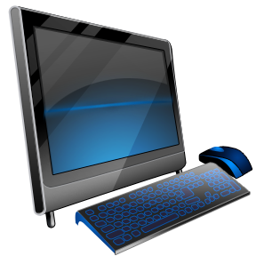


Computer devices

Slide 4
1.What is devices ?
2.What means hardware ?
3.How many devices in computer ?
4.What is computer ?

Slide 5
monitor

Slide 6

MOUSE

Slide 7

KEYBOARD

Slide 8
CPU

Slide 9
PRINTER

Slide 10
SPAKER

Slide 11

-ডিভাইস কি জানতে পারব
_ ডিভাইস কি কাজ ডিভাইস

